Slide 1
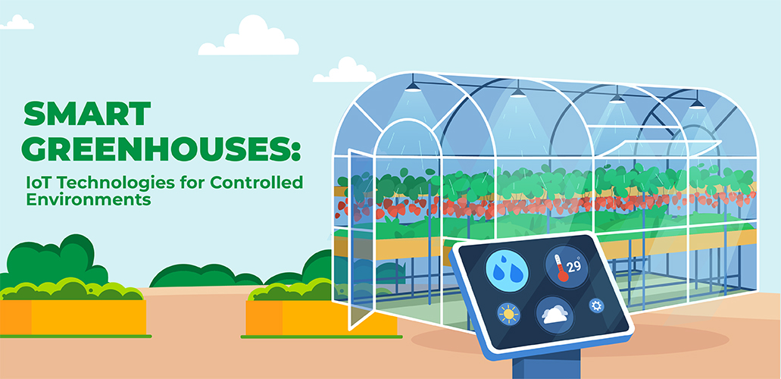

Slide 2
Smart Greenhouse Farm Concept
Objective: Automate soil watering based on real-time moisture, temperature & humidity sensing.
Why: Optimize water usage, ensure plant health, enable remote monitoring and control.
Key Features:
Local MQTT control (reliable LAN)
Cloud connectivity via Adafruit IO (remote dashboards & alerts)
Actuation (valve open/close) and audible alerts (buzzer)

Slide 3
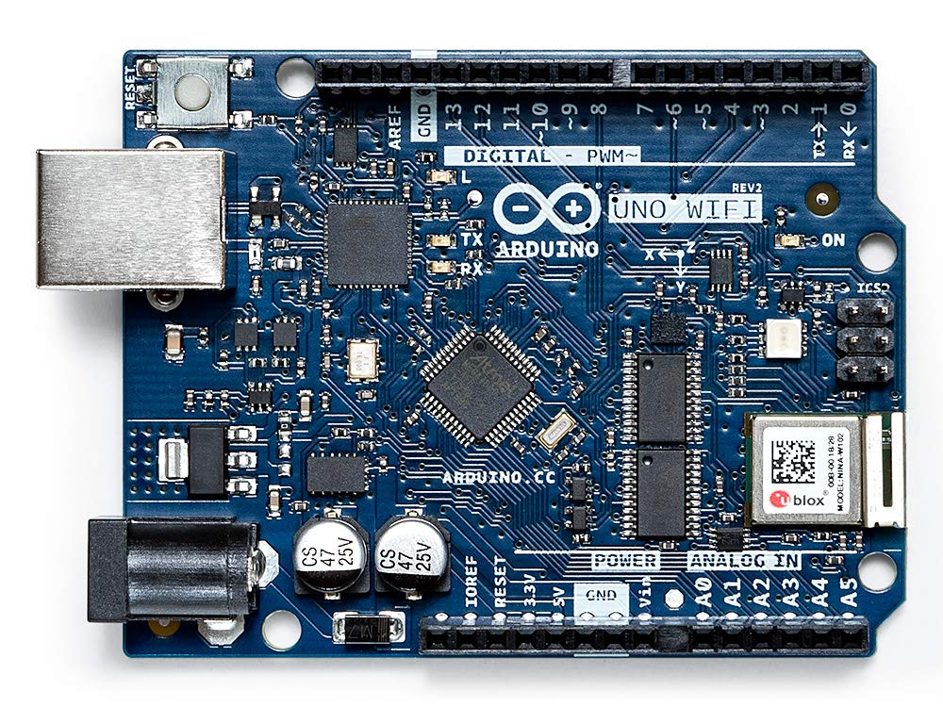
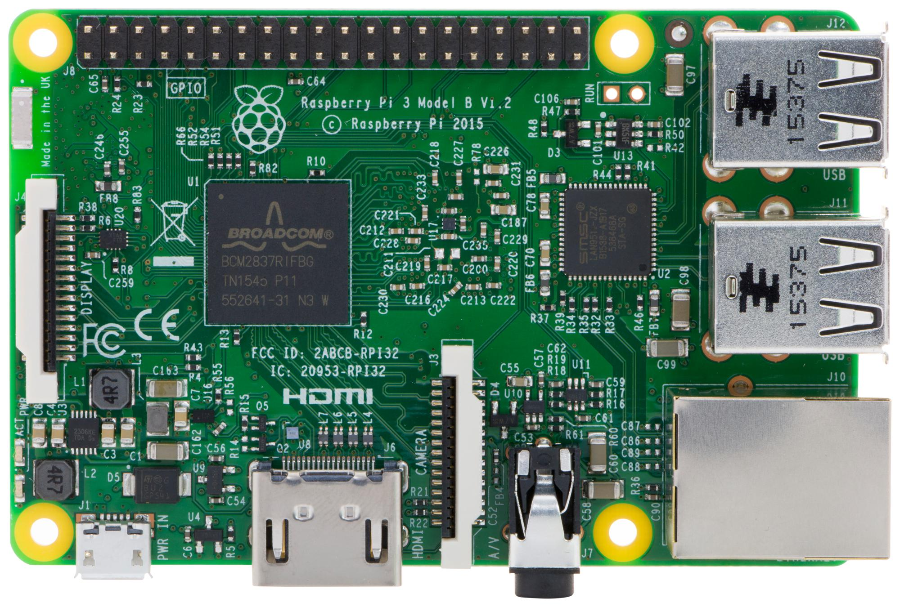
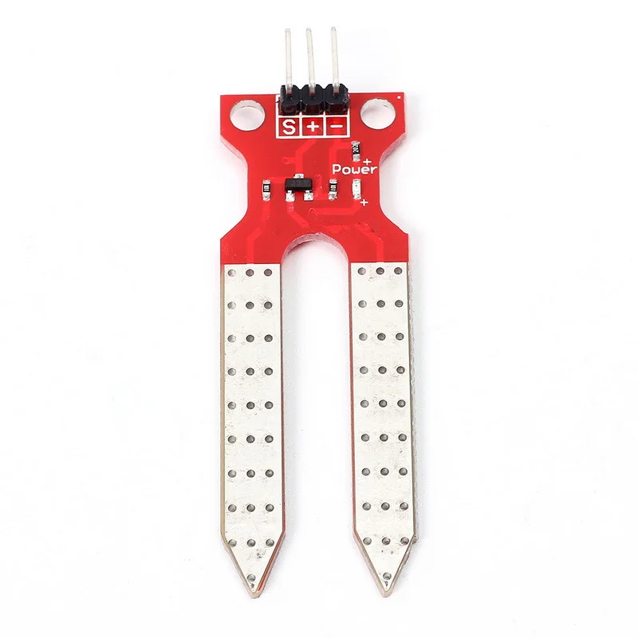
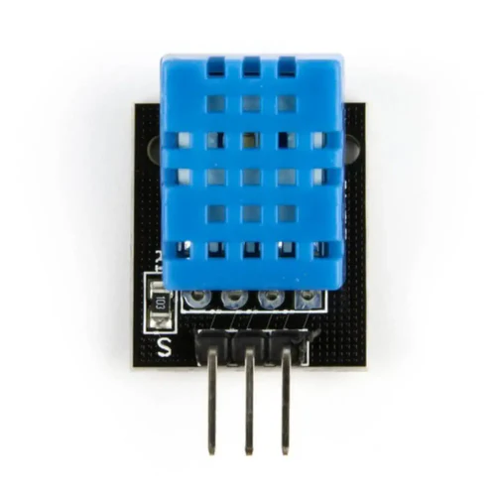
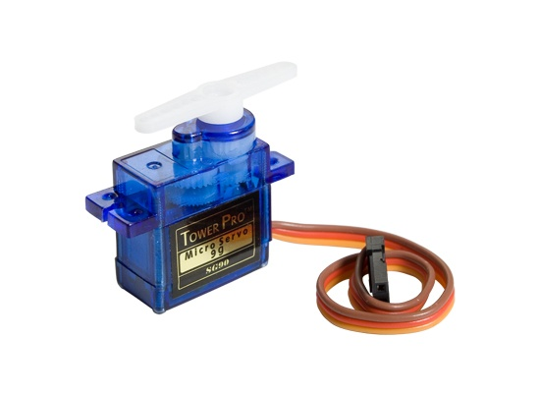

Hardware Components & Roles
Publisher Arduino: Reads- Soil moisture sensor, DHT11 (temp / humidity on D2)
Publishes: Sensor data every to MQTT and Adafruit IO
Actuators: Servo motor (valve on D9), active buzzer (alert on D8)
Raspberry Pi: Runs Mosquitto broker for local MQTT Dash
Soil Moisture Sensor
Temp/Humm sensor
Servo Motor
Active Buzzer

Slide 4
References
https://www.maamoon.com/product-page/5v-active-buzzer
https://www.aranacorp.com/en/control-a-servo-with-arduino/
https://sastronlimited.com/product/soil-moisture-sensor-red-3-pin/
https://de.farnell.com/raspberry-pi/raspberrypi3-modb-1gb/sbc-raspberry-pi-3-model-b-1gb/dp/2525225

